Slide 1

Course advisement for 2016-2017
Crowley ISD

Slide 2
Welcome!
Today you will receive:
A copy of your transcript
A review of graduation requirements
Upcoming EOC dates
Instructions to build 4 year plan in Naviance
A timeline for making course requests for your next school year

Slide 3
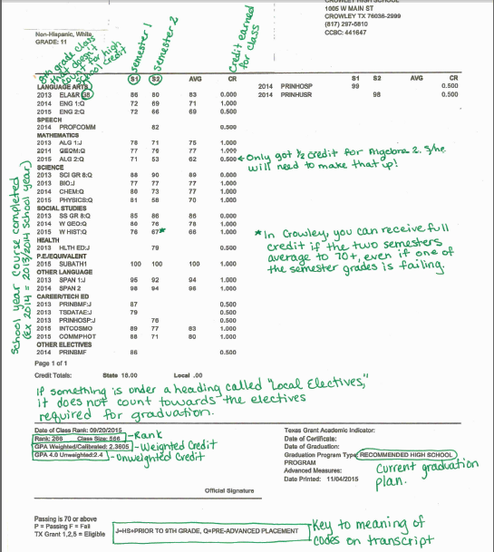
Sample Transcript

Slide 4
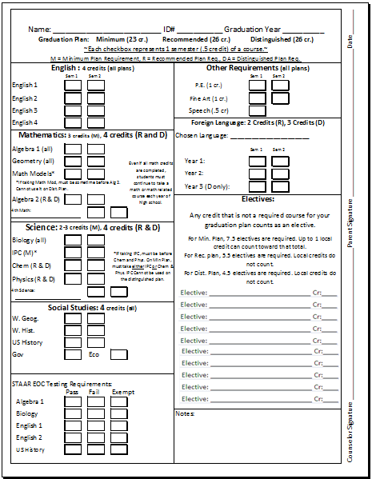
Sample Credit Check Sheet

Slide 5
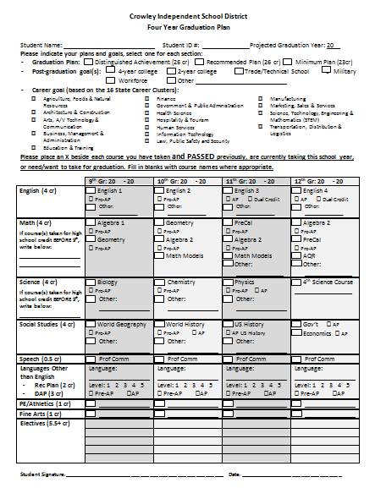
Sample 4 year plan (PGP)

Slide 6
Which graduation program are you pursuing?
Recommended
(26 credits)
Distinguished
(26 credits)
4 English
4 Math
4 Science
4 Social Studies
1 Fine Art
1 PE
2 Foreign Language
0.5 Professional Communication
5.5 electives
4 English
4 Math
4 Science
4 Social Studies
1 Fine Art
1 PE
3 Foreign Language
0.5 Professional Communication
4.5 electives
AND FOUR ADVANCED MEASURES

Slide 7
English – 4 credits
Recommended
Distinguished
English 1 (*)
English 2 (*)
English 3 (**) (D)
English 4 (**) (D)
English 1 (*)
English 2 (*)
English 3 (**) (D)
English 4 (**) (D)
(*) Pre-AP option available
(**) Advanced Placement option available
(D) Dual Credit options available

Slide 8
Mathematics – 4 CREDITS
Recommended
distinguished
Algebra 1 (*)
Geometry (*)
Math Models**
Algebra 2 (*)
Advanced Quantitative Reasoning (“AQR”)
Pre-AP PreCalculus
AP Statistics
Calculus
AP Calculus AB
AP Calculus BC
Algebra 1 (*)
Geometry (*)
Algebra 2 (*)
Advanced Quantitative Reasoning (“AQR”)
Pre-AP PreCalculus
AP Statistics
Calculus
AP Calculus AB
AP Calculus BC
Underlined items must be part of the credits for this category
(*) Pre-AP Option Available
**Math Models must be completed BEFORE Algebra 2 in order for it to apply as one of the four required Math credits (not able to be used on the Distinguished Plan at all.)

Slide 9
Science – 4 Credits
recommended
distinguished
Biology (*)
IPC***
Chemistry (*)
Physics (**)
4th Science Options: Environmental
Systems, Anatomy & Physiology,
AP Environmental Science, AP
Biology, AP Chemistry,
AP Physics 1, 2, and C,
Microbiology/Pathophysiology, Aquatic
Science, Earth and Space Science,
Forensic Science (CTE), Advanced Animal
Science (CTE), Food Science (CTE)
Biology (*)
Chemistry (*)
Physics (**)
4th Science Options: Environmental
Systems, Anatomy & Physiology,
AP Environmental Science, AP
Biology, AP Chemistry,
AP Physics 1, 2, and C,
Microbiology/Pathophysiology, Aquatic
Science, Earth and Space Science,
Forensic Science (CTE), Advanced Animal
Science (CTE), Food Science (CTE)
Underlined items MUST be part of the credits for this category
(*) Pre-AP option available
(**) Advanced Placement option available
IPC must be completed before Chemistry and Physics if it is to be used as a science credit. It may not be used on the Distinguished plan as a science credit.

Slide 10
Social studies – 4 credits
recommended
distinguished
World Geography (*) (**)
World History (*) (**)
US History (**) (D)
US Government (1/2 credit) (**) (D)
Economics (1/2 credit) (**) (D)
World Geography (*) (**)
World History (*) (**)
US History (**) (D)
US Government (1/2 credit) (**) (D)
Economics (1/2 credit) (**) (D)
(*) Pre-AP option available
(**) Advanced Placement option available
(D) Dual Credit options available

Slide 11
Foreign language
recommended
distinguished
2 credits of the SAME Foreign Language
3 credits of the SAME Foreign Language
Pre-AP and Advanced Placement options available starting in the second year of the language in Foreign Languages
*Languages taken in Middle School typically do not count for high school credit unless they were knowingly taken as a high school credit course.*

Slide 12






Physical Education
One Credit Required
Can come from:
Athletics
PE
JROTC
Or the 1st semester of the first two years that a student participates in Band, Color Guard, Cheer, or Drill Team
*PE and Athletics taken in middle school do not fulfill the high school PE requirement

Slide 13



Fine arts
One credit of Fine Art required
Can come from:
Art
Theater (Regular, Production, or Technical)
Dance
Choir
Band
Drill Team
Principals of Floral Design
Music Theory
*Fine arts taken in middle school do not fulfill the high school fine art requirement

Slide 14

Speech
½ credit required
Can come from:
Professional Communications
Dual Credit Professional Communications
Full credit of AVID 4

Slide 15

Electives?
What’s your plan after high school??????

Slide 16
Other means of credit
Credit by Exam – Offered for both advancement and recovery. See your counselor for details.
Dual Credit – Can be done through the school in English and Social Studies starting Junior year, or can be done over the summer.

Slide 17
Distinguished: Advanced Measures
For Distinguished Achievement, students must achieve a TOTAL of FOUR Advanced Measures. A student may satisfy this requirement by:
A score of three or higher on an Advanced Placement Exam (Just taking the class does NOT get an Advanced Measure. You must attain a three or higher on the exam.
A grade of 80 or above in a dual credit course
A score on the PSAT that qualifies a student for recognition as a Commended Scholar or higher by the National Merit Scholarship Corporation. The PSAT score may count as only one advanced measure regardless of the number of honors received by the student.
Original Research Project: that is conducted under the direction of mentor(s) and judged by a panel of professionals in the field and related to the required curriculum TEKS.

Slide 18

Interested in exploring the new Foundation Graduation Plan with Endorsements and possible Distinguished Level of Achievement – schedule a meeting with your counselor to see if it would be right for you! A copy of the Graduation Toolkit from the Texas Education Agency may be found at this website - http://www.tea.state.tx.us/brochures/
Foundation – Only 22 Credits | Foundation +Endorsements 26 Credits | Distinguished Level of Achievement 26 Credits

Slide 19
STAAR End of course exams (EOC’s)
Each student must receive a passing score on each of the following exams in order to be eligible for graduation:
English 1
English 2
Algebra 1
Biology
US History

Slide 20
Naviance instructions
Go to:
https://connection.naviance.com/crowleyhs
Login is (Firstinitial)(Lastinitial)ID
Password is your ID
Example: Bob Williams, ID 12345
Login: BW12345
Password: 12345

Slide 21
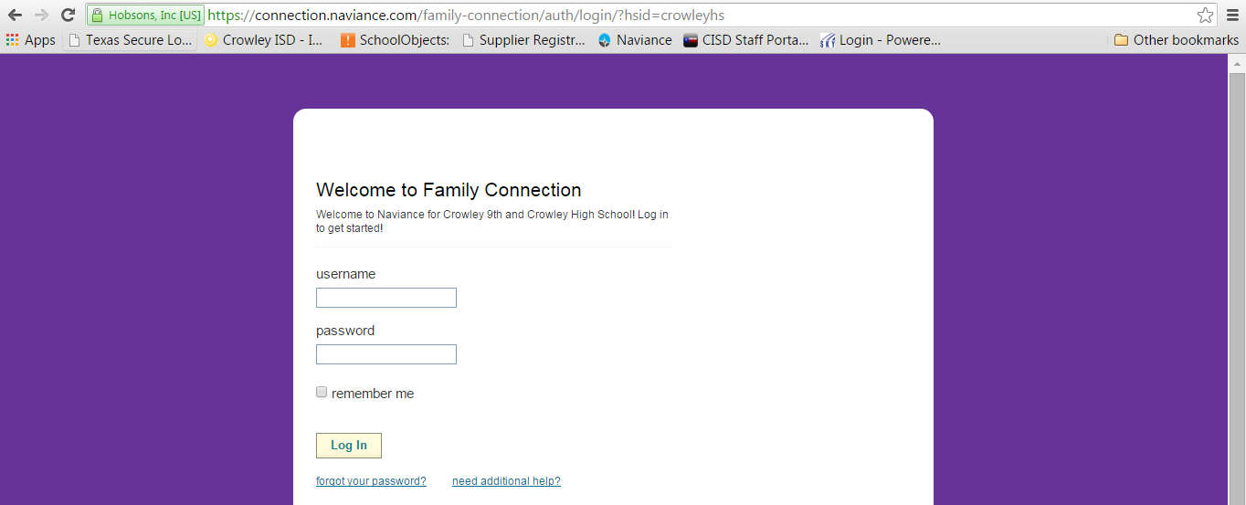
Login page
LOGIN HERE
Username: FL#####
Password: #####

Slide 22
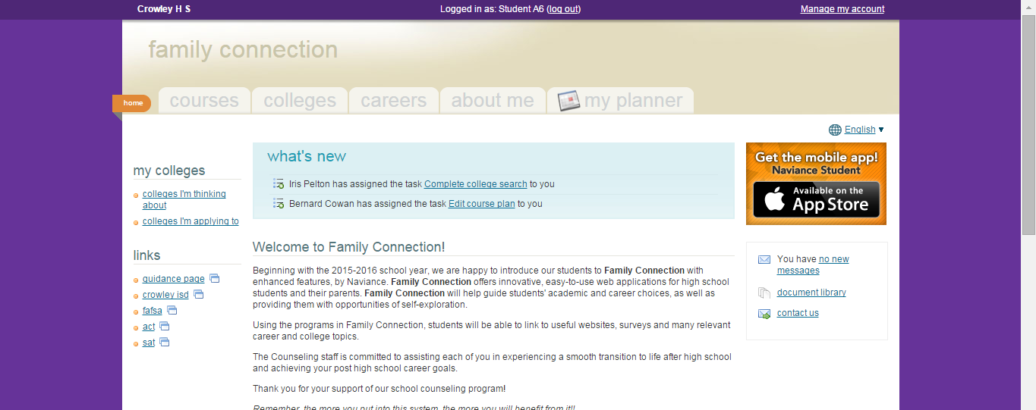
CLICK HERE

Slide 23
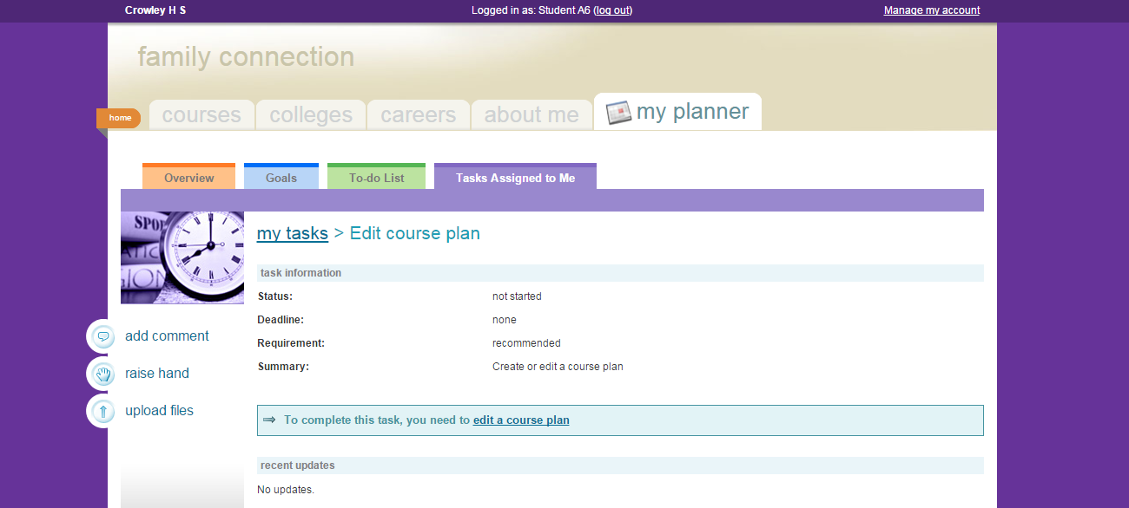
CLICK HERE

Slide 24
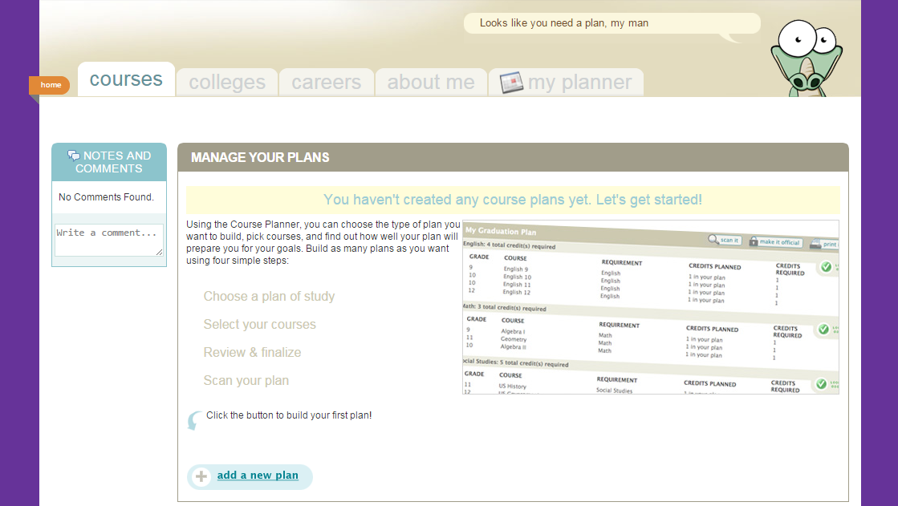
CLICK HERE

Slide 25
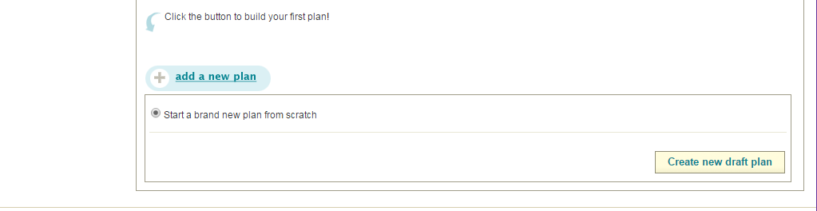
Today, we will start a new plan from scratch!
If you work on it after today, you might choose to edit an already started plan, such as the one we start in class today.
CLICK HERE

Slide 26
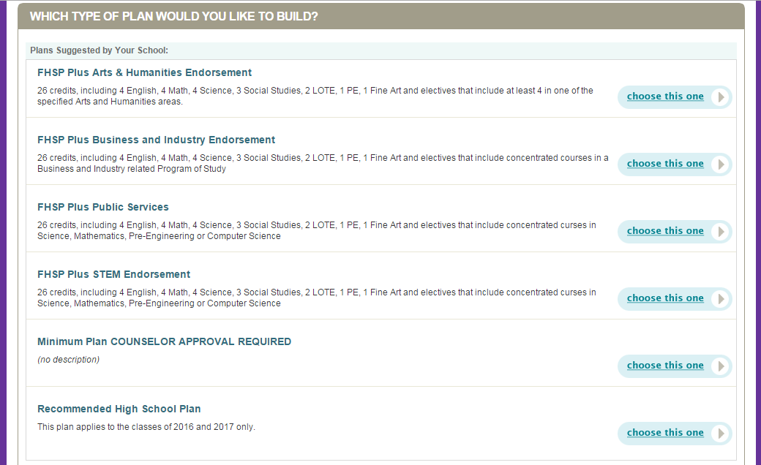
Choose the plan you are going to graduate on. For many of you, it is the Recommended High School Plan.

Slide 27
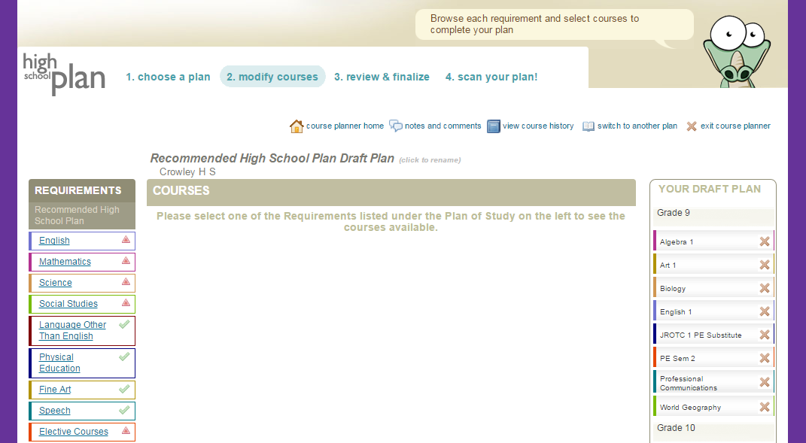
YOU CAN MAKE A NOTE TO YOUR COUNSELOR
SUBJECT AREAS TO FILL
CLASSES YOU’VE TAKEN OR ARE TAKING
GO AHEAD AND CLICK ON ENGLISH

Slide 28
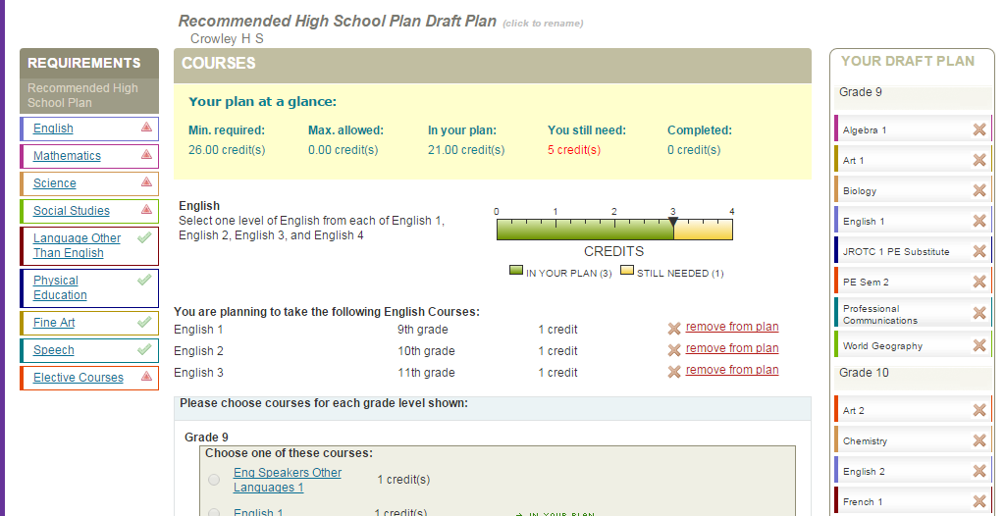
OVERVIEW OF CREDITS CHOSEN
INSTRUCTIONS ABOUT WHAT TO CHOOSE ON THIS PAGE
SCROLL DOWN…..

Slide 29
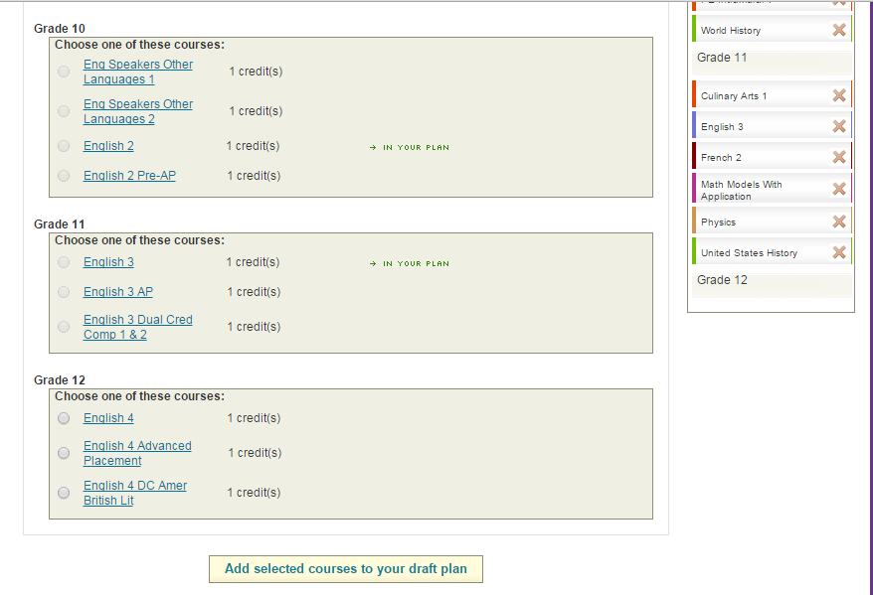
THIS MEANS IT IS ALREADY IN YOUR PLAN. YOU DON’T HAVE TO SELECT IT AGAIN.
CHOOSE COURSES TO MEET THE REQUIREMENTS
CLICK HERE TO ADD THEM TO YOUR PLAN!

Slide 30
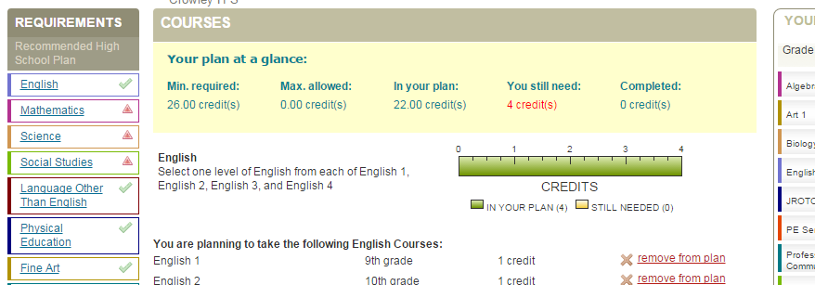
ONCE YOU’VE MET THE REQUIREMENTS FOR THAT SUBJECT AREA, THE RED TRIANGLE CHANGES TO A GREEN CHECKMARK!
THEN, YOU KEEP GOING THROUGH THE SUBJECTS UNTIL ALL REQUIREMENTS ARE MET

Slide 31
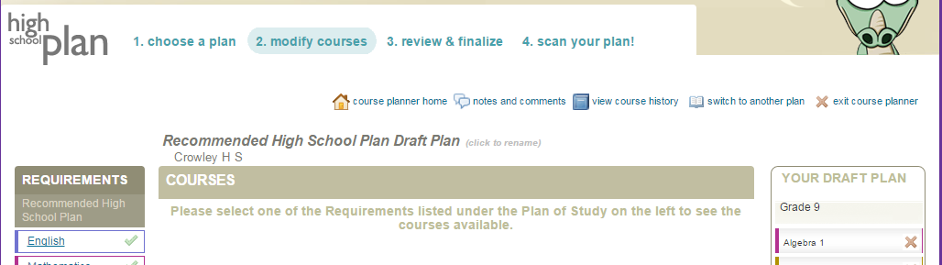
ONCE ALL REQUIREMENTS ARE MET AND YOUR 4 YEAR PLAN IS COMPLETE, CLICK HERE

Slide 32
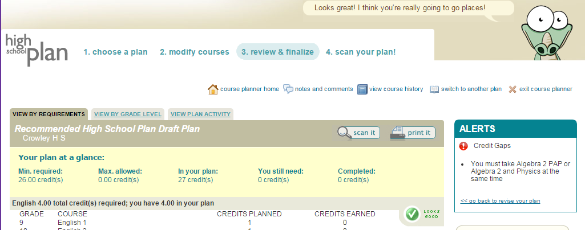
ONCE YOU’RE DONE, YOU CAN EXIT THE COURSE PLANNER! (scan your plan is not working yet)
USE THESE TABS TO VIEW YOUR COURSE PLAN AND MAKE SURE IT IS JUST THE WAY YOU WANT IT!

Slide 33
Contact Information for Counselors at Each Campus
Crowley High School 817-297-5810 | Bill R. Johnson CTE 817-297-3018
Iris Pelton (Students with last names A-G) Iris.pelton@crowley.k12.tx.us | Amy Kuhns amy.kuhns@crowley.k12.tx.us
Bernard Cowan (Students with last names H-O) Bernard.cowan@crowley.k12.tx.us | Mike Mabry Michael.mabry@crowley.k12.tx.us
Melissa Jenkins (Students with last names P-Z) Melissa.Jenkins@crowley.k12.tx.us
Cara Hyatt (“Freshmores” and Special Education) Cara.hyatt@crowley.k12.tx.us

Slide 34
Online Course Selection
Online course selection will be open to students starting November 30th , 2015– January 15, 2016! Be sure to message or meet with your counselor if you have questions about your course selections for the 2016-2017 school year. You may also contact Mrs. Kuhns or Mr. Mabry at the BRJ CTE Center. Here is a quote to get you on your way to good course planning for your success in high school and beyond:
“Planning is bringing the future into the present so that you can do something about it now. “- Alan Lakein

